Slide 1
SMART MIRROR

Slide 2
INDEX
COMPANY PORTFOLIO
INDEX
1. INTRODUCTION
2. DESIGN LAYOUT
3. SOFTWARE SETUP
4. HARDWARE SETUP

Slide 3
INTRODUCTION Artificial Intelligence:- Artificial intelligence (AI) is a constellation of technologies- from machine learning to natural learning processing- that allows machines to sense, comprehend, act and learn.
INTRODUCTION
COMPANY PORTFOLIO
Why It Matters
Artificial intelligence will transform the relationship between
People and technology, charging our creativity and skills.
Where It’s Going
The future of AI promises a new era of disruption and productivity, where human ingenuity is enhanced by speed and precision.
Some AI-based services and tasks are relatively trivial-such as a song recommendation on a streaming music platform, a smart plug, smart mirror , etc. However AI is playing an expanding role in other areas with far greater human impact.
AI won’t replace people, but will complement and support them so they can make better, faster, more accurate and more consistent decisions.

Slide 4
Appications of Artificial Intelligence in SMART MIRROR
INTRODUCTION
COMPANY PORTFOLIO
ARTIFICIAL INTELLIGENCE
IMAGE
PROCESSING
FACE
RECOGNITION
SPEECH
RECOGNITION
OpenCV
SMART MIRROR

Slide 5



IMAGE PROCESSING
INTRODUCTION
COMPANY PORTFOLIO
“Image Processing” is what it intuitively suggests.
Image processing is IMAGE + PROCESSING .
What is an Image?
• Image is a collection of PIXELS.
• Each pixel is like an array of numbers.
• These numbers determine the color of the pixel.
Now let me introduce you to different types of images. There are three types of images:
IMAGE
IMAGE
IMAGE

Slide 6

INTRODUCTION
COMPANY PORTFOLIO
Each kind of image has few attributes attached to it like number of channels and depth .
• Number of channels : Defines the dimension
of array , each pixel
is.
• Depth : Defines the maximum bit size of the
number which is stored in the array
Let’s have a closer look at different
types of images.
Again, as the name suggest each number associated with the pixel can have just one of the two possible values.
• Each pixel is a 1 bit number.
• It can take either 0 or 1 as its value.
• 0 corresponds to Black

Slide 7


INTRODUCTION
COMPANY PORTFOLIO
• 1 corresponds to White
• Number of channels of a binary Image is 1
• Depth of a binary image is 1(bit)
EXAMPLE OF BINARY IMAGE
• Each pixel is a 8 bit number
• It can take values from 0-255
• Each value corresponds to a shade between black and white( 0 for black and 255 for white)

Slide 8


INTRODUCTION
COMPANY PORTFOLIO
Number of channels for a grayscale image is 1
• Depth of a gray scale image is 8(bits)
EXAMPLE OF GRAYSCALE IMAGE
Each pixel stores three values:
1. R : 0-255
2. G : 0-255
3. B : 0-255
• Each number between 0-255 corresponds to a shade of corresponding color

Slide 9

INTRODUCTION
COMPANY PORTFOLIO
Depth of a RGB image is 8(bits)
• Number of channels for a RGB image is 3
EXAMPLE OF RGB IMAGE

Slide 10
FACE RECOGNITION
INTRODUCTION
COMPANY PORTFOLIO
A Face Recognition system is a technology capable of identifying or verifying a person from a digital image or a video frame from a video source. There are multiple methods in which facial recognition systems work, but in general ,they work by comparing selected facial features from described as a biometric artificial intelligence based on application that can uniquely identify a person analyzing patterns based on the person’s facial textures and shapes.
Applications of facial recognition
Mobile platforms
ID certification
Face ID

Slide 11

OpenCV OpenCV is a cross-platform library using which we can develop real-time computer vision applications. It mainly focuses on image processing, video capture and analysis including features like face detection and object detection. Let’s start the chapter by defining the term "Computer Vision". Computer Vision Computer Vision can be defined as a discipline that explains how to reconstruct, interrupt, and understand a 3D scene from its 2D images, in terms of the properties of the structure present in the scene. It deals with modeling and replicating human vision using computer software and hardware.
INTRODUCTION
COMPANY PORTFOLIO

Slide 12
INTRODUCTION
COMPANY PORTFOLIO
Computer Vision overlaps significantly with the following fields −
• Image Processing − It focuses on image manipulation.
• Pattern Recognition − It explains various techniques
to classify patterns. • Photogrammetry − It is concerned with obtaining
accurate measurements from
images.
Computer Vision Vs Image Processing
Image processing deals with image-to-image transformation. The input and output of image processing are both images.
Computer vision is the construction of explicit, meaningful descriptions of physical objects from their image. The output of computer vision is a description or an interpretation of structures in 3D scene.

Slide 13
INTRODUCTION
COMPANY PORTFOLIO
Applications of Computer Vision
Here we have listed down some of major domains where
Computer Vision is heavily used.
Robotics Application
• Localization − Determine robot location automatically
• Navigation
• Obstacles avoidance
• Assembly (peg-in-hole, welding, painting)
• Manipulation (e.g. PUMA robot manipulator)
• Human Robot Interaction (HRI) − Intelligent robotics to interact with and serve people
Medicine Application
• Classification and detection (e.g. lesion or cells classification and tumor detection)
• 2D/3D segmentation
• 3D human organ reconstruction (MRI or ultrasound
Vision guided robot surgery.
Industrial Automation Application
• Industrial inspection (defect detection)
• Assembly
• Barcode and package label reading
• Object sorting
• Document understanding (e.g. OCR)

Slide 14
INTRODUCTION
COMPANY PORTFOLIO
Security Application
• Biometrics (iris, finger print, face recognition)
• Surveillance − Detecting certain suspicious activities or behaviors
Transportation Application
• Autonomous vehicle
• Safety, e.g., driver vigilance monitoring

Slide 15
Speech recognition Speech recognition is the ability of a machine or program to identify words and phrases in spoken language and convert them to a machine-readable format.
INTRODUCTION
COMPANY PORTFOLIO
In the smart mirror first we send the voice command with the help of a Microphone.
Two microphones are used to power the voice recognition capabilities of a device.
The voice recognition system works by listening for someone to clap or give a specific command like OK GOOGLE in google assistant with the first microphone and once that happens the second, higher quality microphone is triggered to listen for a voice command.

Slide 16
INTRODUCTION
COMPANY PORTFOLIO
The command is then received by the Raspberry pi and transferred to the Google assistant or Cloud speech to text.
In Cloud speech an ADC translates the analog waves of your voice into digital data by sampling the sound. The higher the sampling and precision rates, the higher the quality. Hence converting the given speech into a text message.
After receiving the text we will command for getting the desired functions like search results, social notifications, music and video streaming etc.
Hence acknowledging the output via the speaker as well as the Smart Mirror itself.

Slide 17
INTRODUCTION
COMPANY PORTFOLIO
What is Smart Mirror
Smart mirrors are straight from science fiction. They’re part of an optimistic vision of the future that imagines a world where screens and data are everywhere, ready to feed you whatever information you need at a moment’s notice. Basically, the mirror looks like a normal mirror but when someone stands in front of it the scene changes. The mirror provides a functional, user friendly and interactive UI to its user for accessing their health information, live location etc. It has widgets for displaying the current weather conditions and time. The Smart Mirror would help in developing smart houses with embedded artificial intelligence, as well as sharing its applications in various industries.
The raspberry pi is programmed using python and connects to a monitor with an inbuilt speaker so as to provide an onscreen interface and voice assistance as well. Section 2 focuses on Design of mirror. The working while making Smart Mirror is covered under Section 3. Section 4 comments on the Functional Overview of mirror. Section 5 covers problems and issues that may occur while development.

Slide 18
What Can A Smart Mirror Do?
INTRODUCTION
COMPANY PORTFOLIO
What makes a Smart Mirror ‘smart’ is the ability to display any information you want on it. A smart mirror can be customized to display local weather forecasts, news bulletins, your upcoming calendar schedule, social media feeds, etc.
It’s possible to even add voice commands using Amazon’s Alexa or Google’s Home Assistant.
How Do Smart Mirrors Work?
There are three components of a smart mirror:-
A Two-Way Mirror
A Display
A Computer device
How These Components Helps To Run Smart Mirror
A Two-way Mirror:- Two-Way Mirror: A normal mirror has a film behind the glass that reflects 100% of incoming light. This means when you look at a mirror, you see your reflection. A two-way mirror reflects light from one direction, but allows light to pass through from the other direction.
A Display:- Behind the two-way mirror sits a monitor screen/TV/tablet. This is used to display any information or modules for your smart mirror. The display can be the same size as the mirror, or it can be smaller than the mirror.
A computer Device:- Something has to run the content you see on your smart mirror. A small computer device such as a Raspberry Pi is more than enough to power a smart mirror.

Slide 19
Advantages of a Smart Mirror:-
INTRODUCTION
COMPANY PORTFOLIO
Like many smart devices, it’s hard to imagine how useful they can be until you use one. The big advantage of a smart mirror is the ability to display useful information without needing to open apps or do anything.
You simply look at your smart mirror and the information is there.
For example, imagine the mirror in your bathroom is a smart mirror. Every morning you probably wake up and stand in front of that mirror as you brush your teeth or prepare for the day.
Imagine while you go through your morning routine you can look at your mirror and see a traffic report, weather forecast for the day, and your day’s schedule.
Being able to take in all of this useful information without interrupting your normal routine is very liberating. You can customize your mirror to display anything you find useful.
Want a news feed for specific topics? Easy. Want to see stock price movements? Done. Want a daily quote to inspire you every morning to go for that run? You got it.
A great advantage of building your own smart mirror is the modules and software other people have already built. There are literally hundreds of different modules other people have built you can use for your smart mirror.
You can fully customize your smart mirror by picking and choosing the modules you want to include.

Slide 20
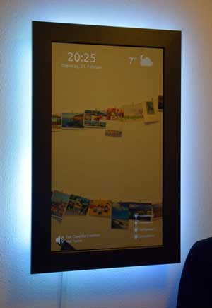
Smart Mirror Features:-
INTRODUCTION
COMPANY PORTFOLIO
Here are some ideas of different features you could include in your smart mirror:
Touch screen: adding touch to your smart mirror let’s you interact with it
LED lighting: a simple LED strip around your smart mirror can add some nice feature lighting to your room
Motion sensor: turn your smart mirror on automatically when you enter your room
Voice control: ask your mirror questions or give it commands
Facial recognition: your mirror can detect who is in the room and customize the content to match each person

Slide 21
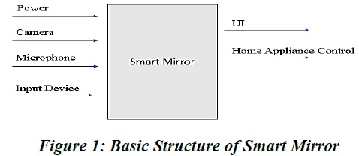
DESIGN LAYOUT
COMPANY PORTFOLIO
Design
Power connection, microphone for voice input, camera for image processing form the basic input devices for the mirror. The monitor and speakers forms the output Design devices of the mirror.
Smart Mirror doesn’t fully display all the equipment that are to be connected to the raspberry pi, but covers all major functional units. The microphone is connected via sound card on USB port of Pi. The camera can be connected to USB port or the Pi camera can be connected to camera slot on Pi. To access the internet the Pi is connected to home Wi-Fi network or with the LAN cable. The programming of the Pi for displaying the UI on the screen is done using Python.

Slide 22
DESIGN LAYOUT
COMPANY PORTFOLIO
WORKING
The working of each components in smart mirror is explained in this section.
1. Two-Way glass mirror
The two-way mirror is what gives the mirror its real identity. It’s really magic mirror as it has reflective surface at one side and also its transparent for light with good intensity. The mirror stays at the front where the user can watch himself/herself in the mirror at the same time the allows the light from monitor to pass through it and make available the UI.
2. Monitor
The monitor is directly connected to Raspberry Pi via HDMI interface thus providing display as well as voice output.
3. Raspberry Pi
The raspberry pi is the most vital part of the mirror, it forms the processing unit of the mirror. The Pi is like motherboard having all the required constituents which forms a great CPU. Its size of a credit card and still it can perform like a full-fledged computer. The programming of Pi is done using Python language. Installation of OS on Raspberry Pi is quite a simple process. First you have to download Raspbian OS which is great OS of Raspberry Pi for beginners. The Raspbian is just a flavor of Debian OS .

Slide 23
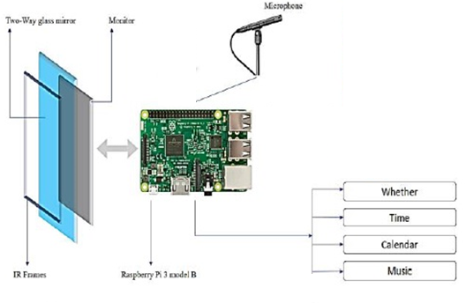
DESIGN LAYOUT
COMPANY PORTFOLIO
4. Microphone
The microphone is used to give voice input to the mirror. Along with touch capability a voice input makes the system very reliable and robust in working. A sensitive microphone takes voice command from the user and processes it to do corresponding action.

Slide 24
DESIGN LAYOUT COMPANY PORTFOLIO
List of Components:
1. Raspberry pi
2. MicroSD card (min 8GB)
3. Display
4. Two way glass mirror
5. Internet access
6. WebCam with Microphone
7. HDMI Cable
8. Mini HDMI Connector
9. USB Cable
10. Display Power Cable
11. Keyboard
12. Mouse

Slide 25
SOFTWARE SETUP
COMPANY PORTFOLIO
2. Software Setup
Step 1: Install Raspbian OS
Step 2: Connect to internet
Step 3: Configure speaker and Microphone
Step 4: Install Git, Download script from Github
Step 5: Update OS and install packages
Step 6: Run script

Slide 26
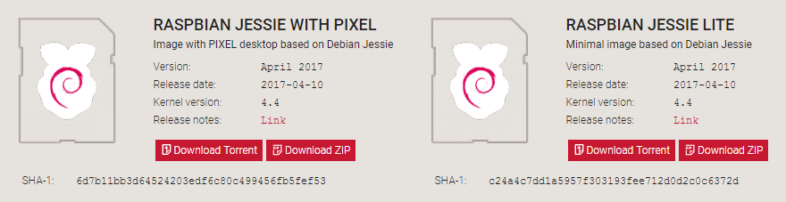
SOFTWARE SETUP
COMPANY PORTFOLIO
Step 1. How to install Raspbian on the Raspberry Pi
Installing Raspbian on the Raspberry Pi is pretty straightforward. We’ll be downloading Raspbian and writing the disc image to a microSD card, then booting the Raspberry Pi to that microSD card. For this project, you’ll need a microSD card (go with at least 8 GB), a computer with a slot for it, and, of course, a Raspberry Pi and basic peripherals (a mouse, keyboard, screen, and power source). This isn’t the only method for installing Raspbian (more on that in a moment), but it’s a useful technique to learn because it can also be used to install so many other operating systems on the Raspberry Pi. Once you know how to write a disc image to a microSD card, you open up a lot of options for fun Raspberry Pi projects.
Step 1.1: Download Raspbian

Slide 27
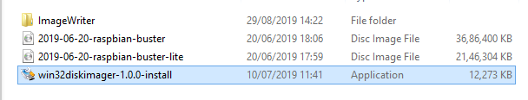
SOFTWARE SETUP
COMPANY PORTFOLIO
First things first: hop onto your computer (Mac and PC are both fine) and download the Raspbian disc image. Give yourself some time for this, especially if you plan to use the traditional download option rather than the torrent. It can easily take a half hour or more to download.
Step 1.2: Unzip the file
The Raspbian disc image is compressed, so you’ll need to unzip it. The file uses the ZIP64 format, so depending on how current your built-in utilities are, you need to use certain programs to unzip it. If you have any trouble, try these programs recommended by the Raspberry Pi Foundation:
Windows users, you’ll want 7-Zip or WinRAR.
Mac users, The Unarchiver is your best bet.
Linux users will use the appropriately named Unzip.
Step 1.3: Follow below steps to install Raspbian OS.
Double click setup file.

Slide 28
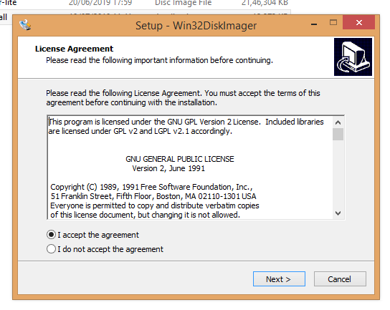
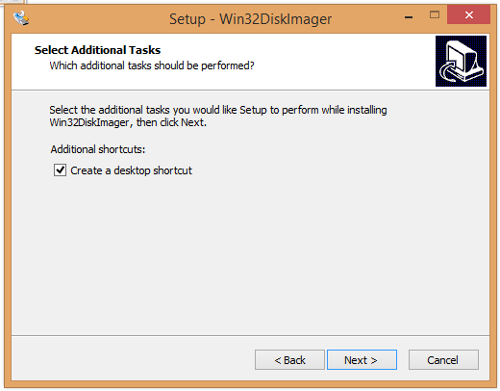
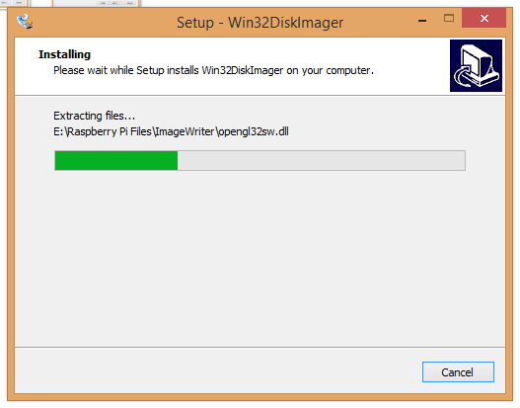
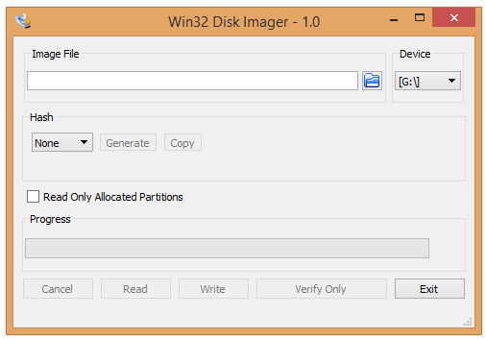
SOFTWARE SETUP
COMPANY PORTFOLIO
Step 1.4: Write the disc image to your microSD card by following the below steps.

Slide 29
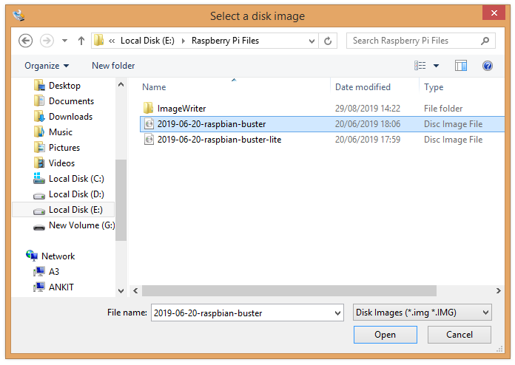
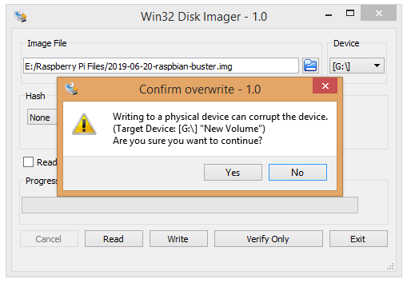
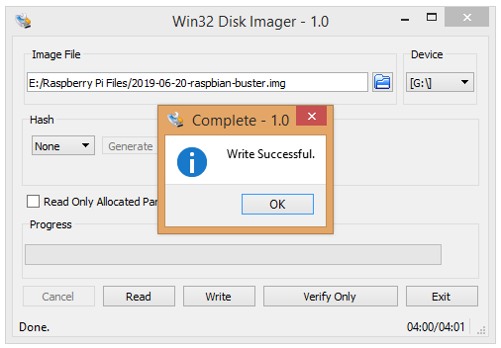
SOFTWARE SETUP
COMPANY PORTFOLIO
Select Raspbian buster
Press Yes
here

Slide 30
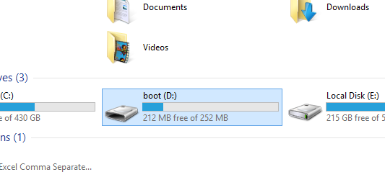
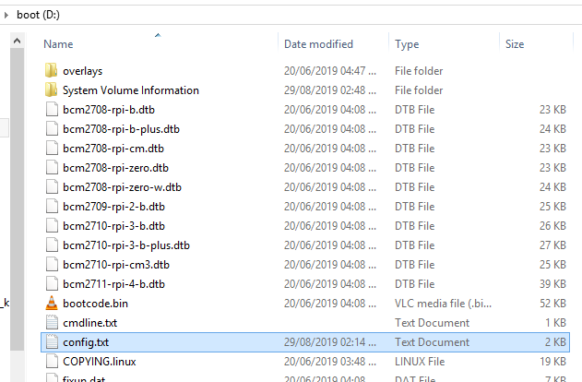
SOFTWARE SETUP
COMPANY PORTFOLIO
Next, pop your microSD card into your computer and write the disc image to it. You’ll need a specific program to do this:
Windows users, your answer is Win32 Disk Imager.
Mac users, you can use the disk utility that’s already on your machine.
Linux people, Etcher – which also works on Mac and Windows – is what the Raspberry Pi Foundation recommends.
Open the card reader drive.
Open the config.txt file.

Slide 31
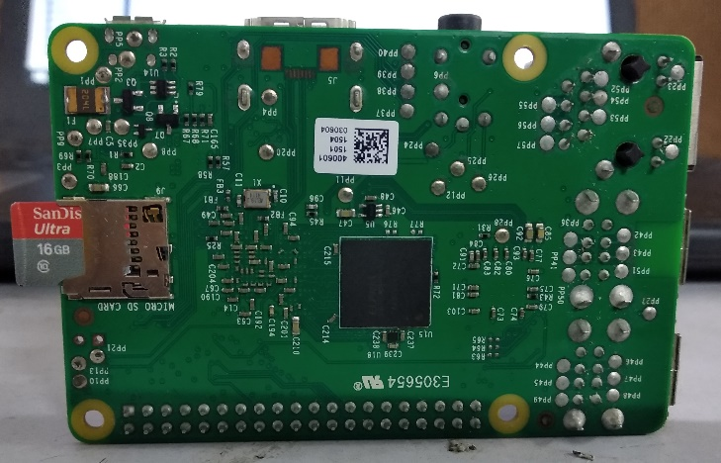
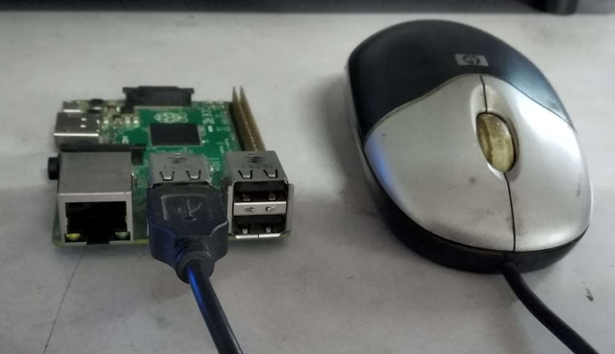
SOFTWARE SETUP
COMPANY PORTFOLIO
Uncomment config_hdmi_boost=4
Uncomment hdmi_force_hotplug=1
Assign value to the display according to the required orientation of screen .
Write display_rotate=0 , for horizontal view of the screen.
Write display_rotate=1 , for rotating the view by 90 clockwise.
Write display_rotate=2 , for rotating the view by 180 clockwise.
Write display_rotate=3 , for rotating the view by 270 clockwise.
Step 1.4: Put the microSD card in your Pi and boot up
Once the disc image has been written to the microSD card, you’re ready to go!
Step 1.5: Connect mouse to the USB port of raspberry pi.

Slide 32
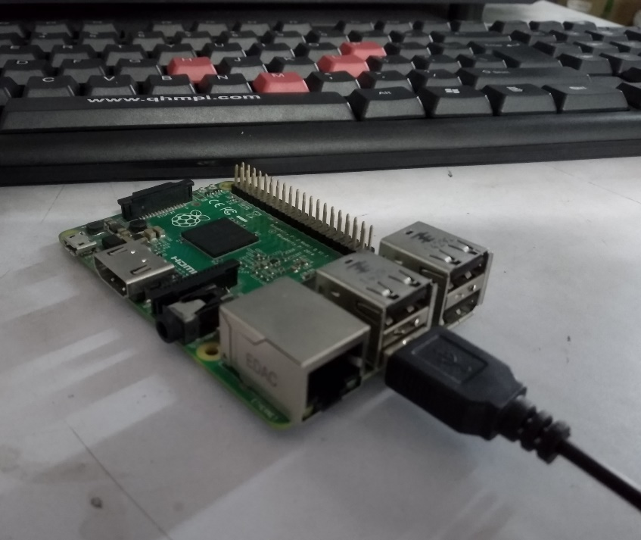
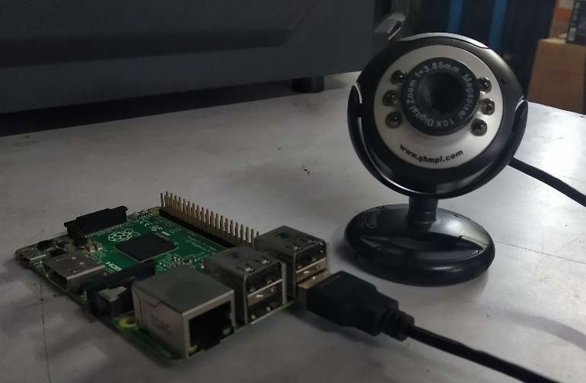
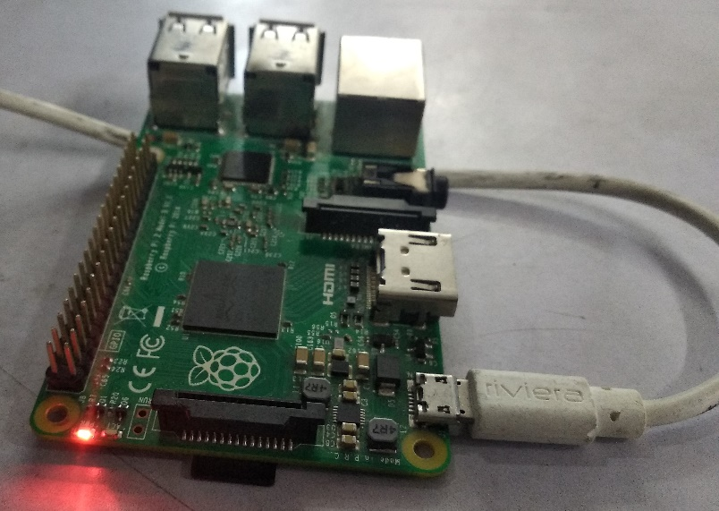
SOFTWARE SETUP
COMPANY PORTFOLIO
Step 1.6: Connect Keyboard to the USB port of raspberry pi.
Step 1.7: Connect Web Camera to the USB port of raspberry pi.
Step 1.8: Connect USB cable to the raspberry pi to power the raspberry pi.

Slide 33
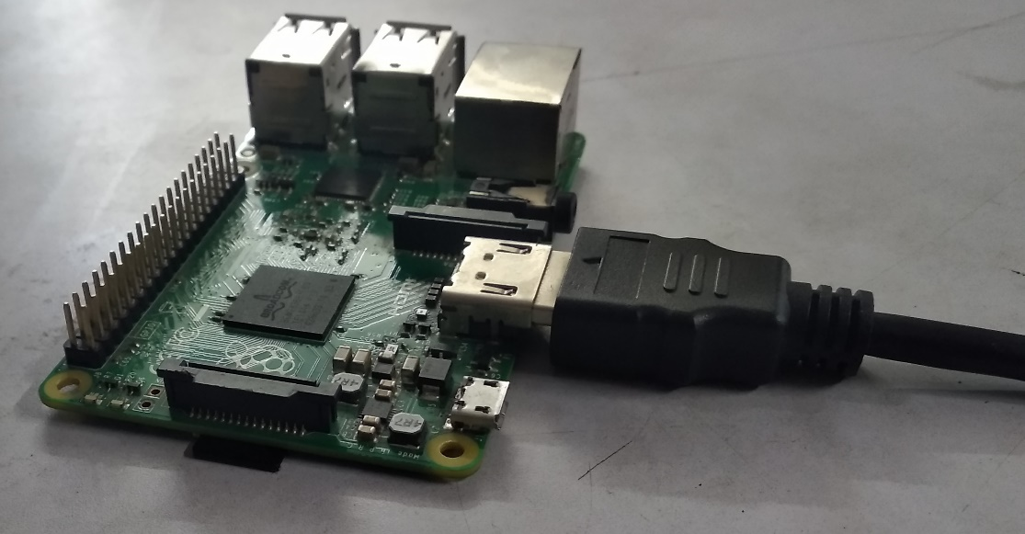
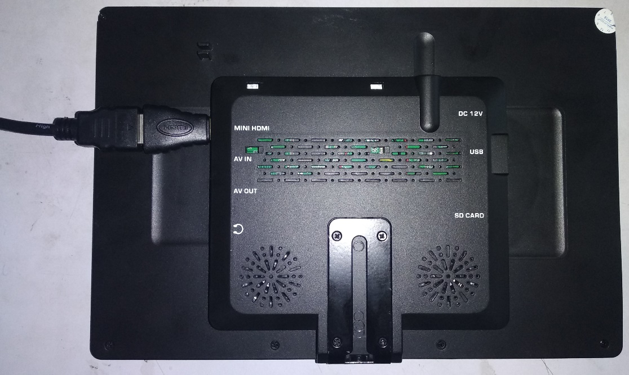
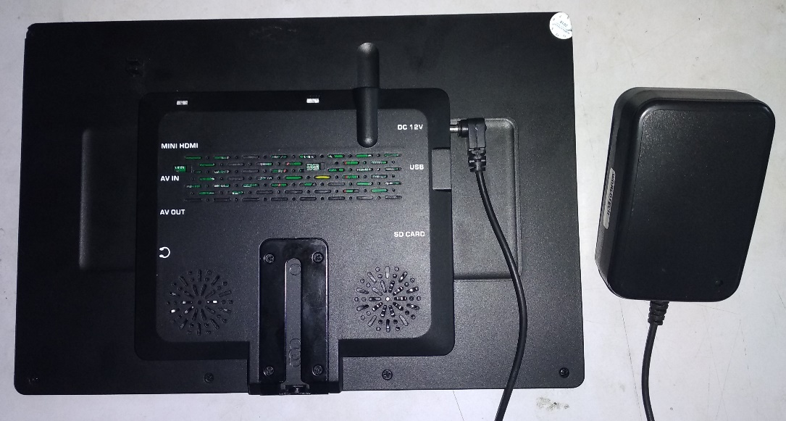
SOFTWARE SETUP
COMPANY PORTFOLIO
Step 1.9: Connect HDMI port of raspberry pi to the mini HDMI port of screen by the use of HDMI cable.
Step 2.0: Connect screen to the power cable.

Slide 34
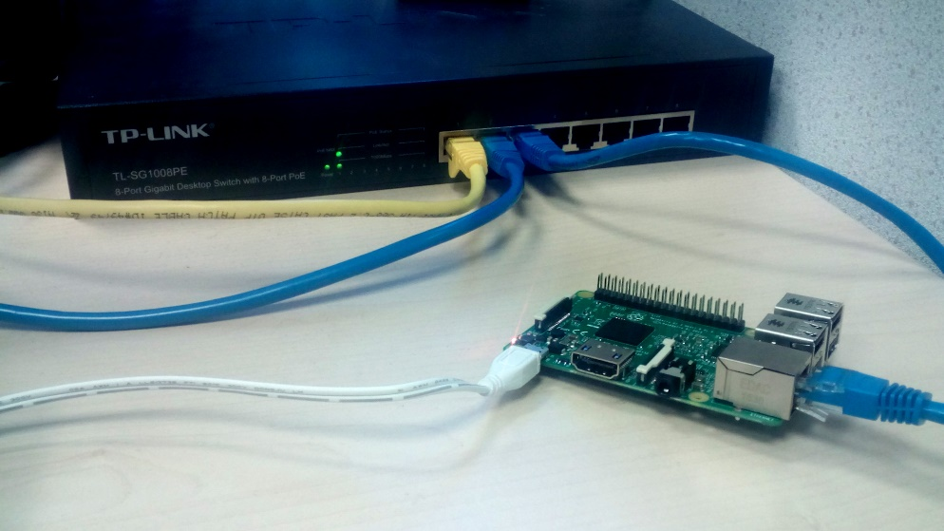
SOFTWARE SETUP
COMPANY PORTFOLIO
Step 2.1:Press the av button on the screen until you get HDMI written on the screen
Step 2: Connect to internet
Wired Ethernet connection
Consumer routers are usually configured to issue an IP address to your devices via DHCP as soon as they are connected. This means that in most cases, connecting your Pi to the internet via a wired Ethernet connection is as simple as connecting your Raspberry Pi to your internet router/switch with a standard Ethernet cable.

Slide 35
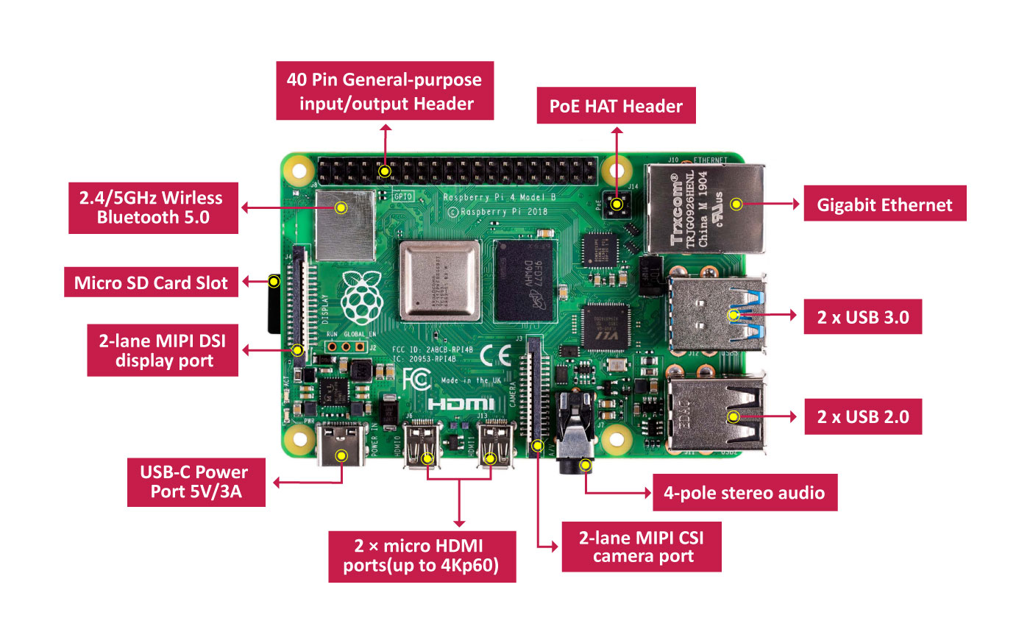
SOFTWARE SETUP
COMPANY PORTFOLIO
Wireless connection
At the time of writing, only Raspberry Pi 3 devices have built in Wifi. For older devices, The WiPy USB Wireless module is available from the Raspberry Pi Store.
Check whether your network is visible and in range
Open a terminal emulator and type in the command below to get a list of networks visible to your Pi:
Syntax:
sudo iw dev wlan0 scan | grep SSID
Configure WiFi
In our case, we set up a network named DATAPLICIT and we will now configure our Pi to connect to it after boot up.
Open up network interfaces file using text editor such as nano.

Slide 36
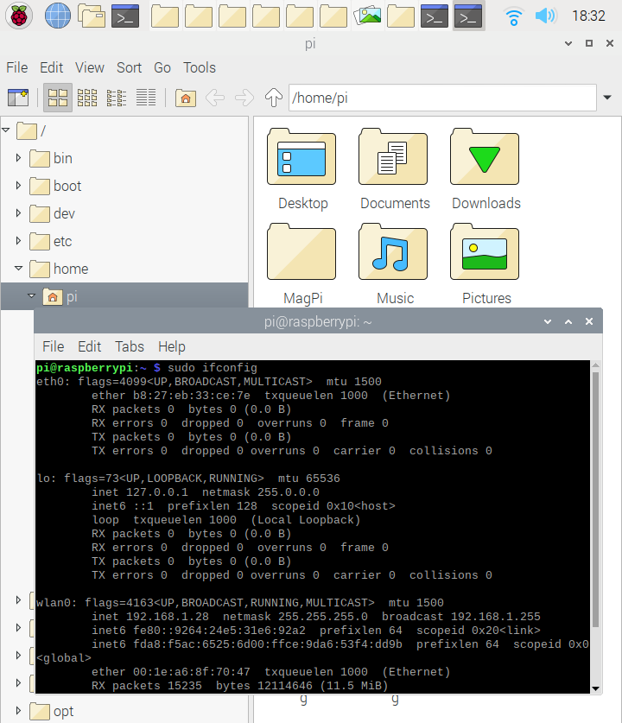
SOFTWARE SETUP
COMPANY PORTFOLIO
Find your IP address
To find the IP of the interfaces on your Raspberry Pi use the command below.
Find IP address of your Pi
Syntax:
sudo ifconfig
You should see a result similar to the one below. To find your IP you have to look at the interface you're currently using e.g. Wlan0 and then look at the inet (IPv4) section.

Slide 37
SOFTWARE SETUP
COMPANY PORTFOLIO
Updating the kernel and firmware
The kernel and firmware are installed as a Debian package, and so will also get updates when using the procedure above. These packages are updated infrequently and after extensive testing.
Running out of space:
When running sudo apt-get dist-upgrade, it will show how much data will be downloaded and how much space it will take up on the SD card. It's worth checking with Syntax: df –h that you have enough free disk space, as unfortunately apt will not do this for you. Also be aware that downloaded package files (.deb files) are kept in Syntax : /var/cache/apt/archives. You can remove these in order to free up space with sudo apt-get clean.
Two versions of python are available on Raspberry Pi :
2.7.x
3.7.x
Out of which we will use 3.7.x
Run command
Syntax :
pip3 --version
If error message occurs (‘ pip’ is not recognized ….)
Run command
Syntax:
sudo apt-get install python3-pip
Else the version of pip will be displayed.

Slide 38
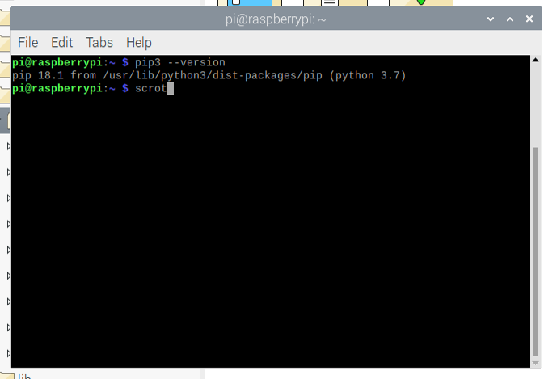
SOFTWARE SETUP
COMPANY PORTFOLIO
Step 3: Connect Microphone and test
If you want to be sure that your microphone works well, the easiest way is to do a recording test. To do this, launch a terminal and type the following command:
Syntax:
arecord -D plughw:1,0 test.wav
Then open the sound file with your favorite audio player to check that the microphone recorded well your voice
For example:
Syntax:
omxplayer test.wav

Slide 39
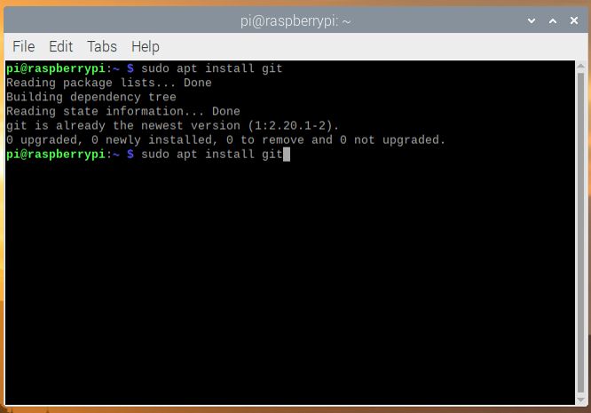
SOFTWARE SETUP
COMPANY PORTFOLIO
Step 4 : Installation of Git:
Git : Git is a distributed version-control system for tracking changes in source code during software development. It is designed for coordinating work among programmers, but it can be used to track changes in any set of files. Its goals include speed, data integrity, and support for distributed, non-linear workflows.
Syntax:
sudo apt install git
Change the folder:
Syntax:
cd Desktop/

Slide 40
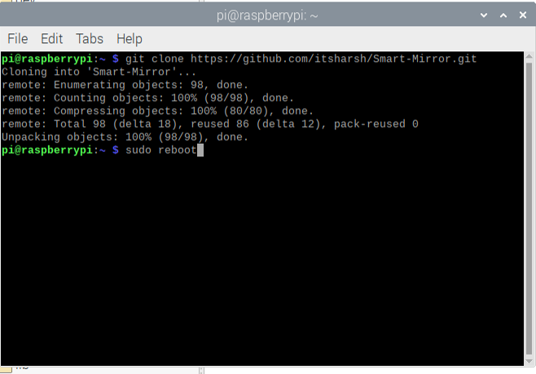
SOFTWARE SETUP
COMPANY PORTFOLIO
Syntax:
git clone https://github.com/itsharsh/Smart-Mirror.git
ls command to check the folder.
Step 5: Update the Linux operating system and install packages.
Open fresh terminal and type:
Syntax:
cd Desktop/Smart-Mirror/
./installer.sh

Slide 41
Step 6: Registration of face.
Open Smart-Mirror folder.
Connect camera to the raspberry pi.
Double click register.py .
Run the code.
Place the camera at a fix point.
Enter your name and email Id and register.
Be in the front of camera until you get message of registration successful.
Register on the Health Positive App.
Step 7: Now run Login.py

